Slide 1
Vue
Chapter 3 & 4
Adding interactivity
Forms, two-way data binding

Slide 2
Starter code
Git clone this repository
https://github.com/claraj/vue-week-2-examples
Working version in the master branch, for reference
You need to check out the base branch
Command line or Webstorm terminal: git checkout base
Webstorm GUI: VCS menu > Git > Branches… > base

Slide 3
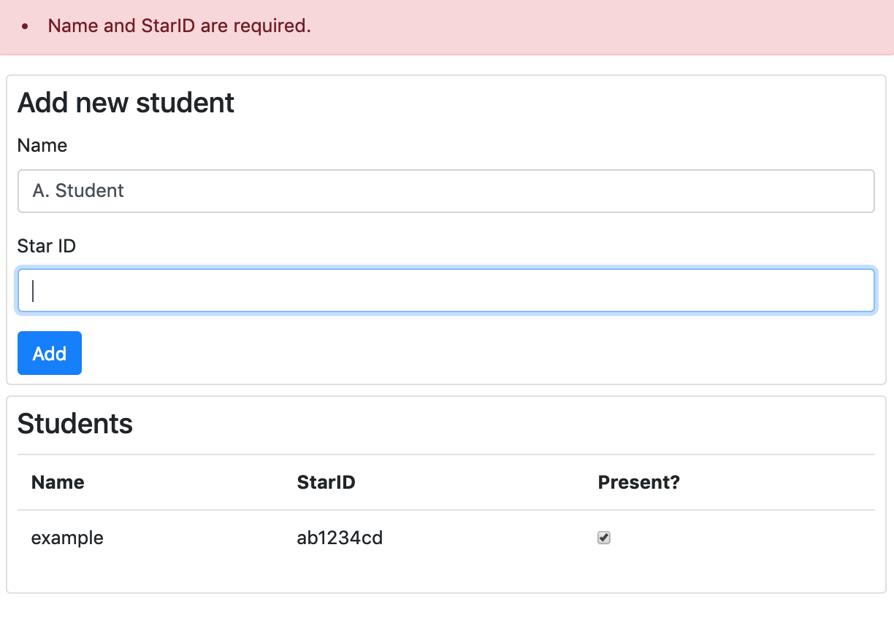
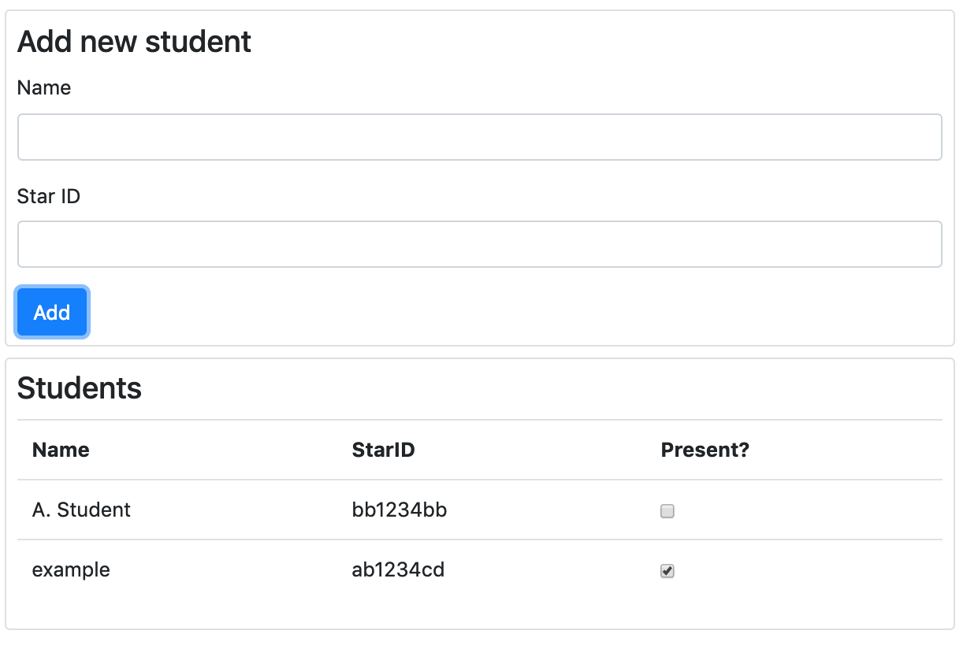
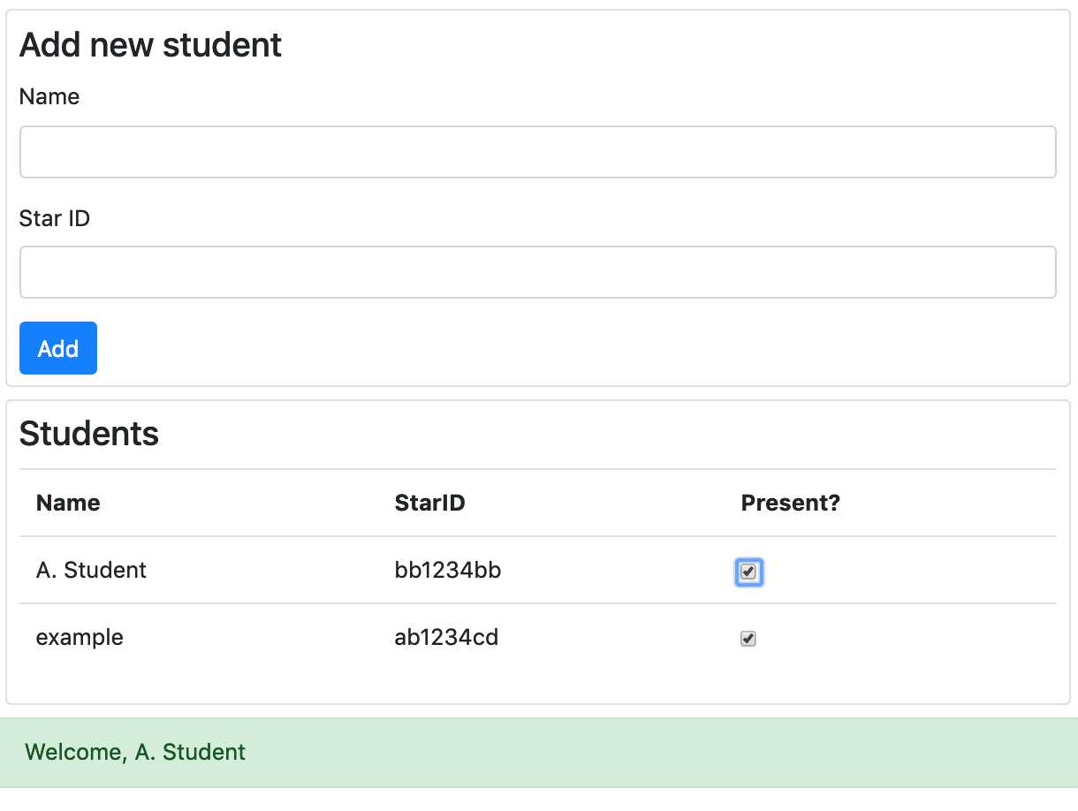
Student sign-in page – working app
Table of student names and StarIDs
Can add a student – name and StarID are required
Check the box by the student's name in the table to sign in/out

Slide 4
Most of the HTML is written for you
Has bootstrap, but bootstrap is not necessary for Vue – just makes the page look a little nicer, for example, tables and alerts
Look for the TODO comments in the HTML template

Slide 5
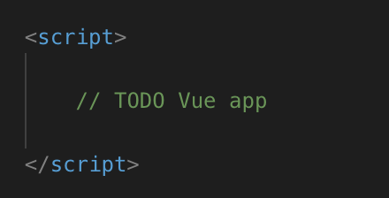
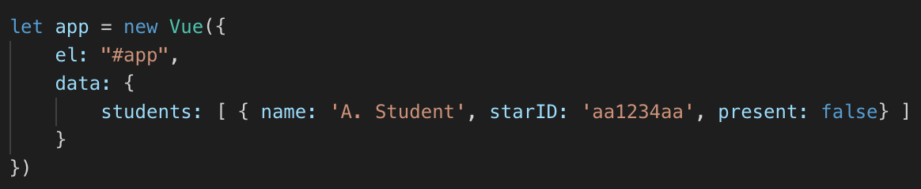
Create new Vue app
At the bottom of student_sign_in.html, replace // TODO Vue app with this
Example student object in list

Slide 6
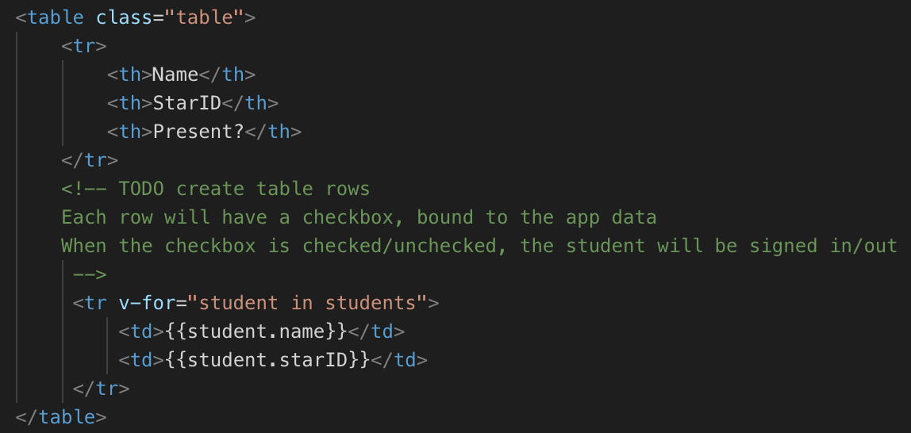
Displaying data in table
Find the table element, around line 40
Add a new tr element
Use v-for to iterate over student list and display info for each student

Slide 7
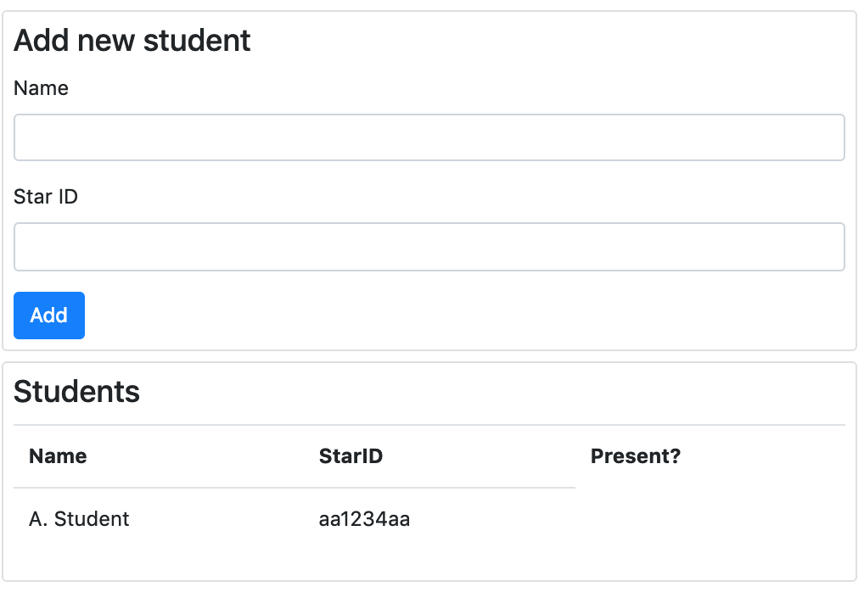
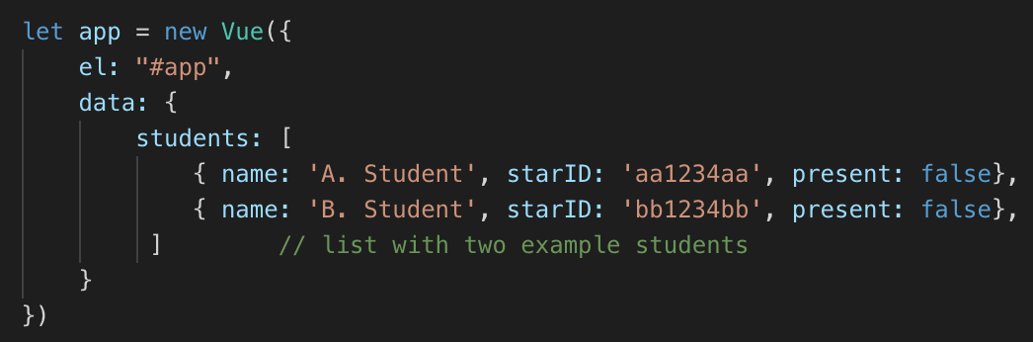
Name, starID in table
We'll add the checkbox soon
Your turn: add another example student
Verify there are two rows, one for each student

Slide 8
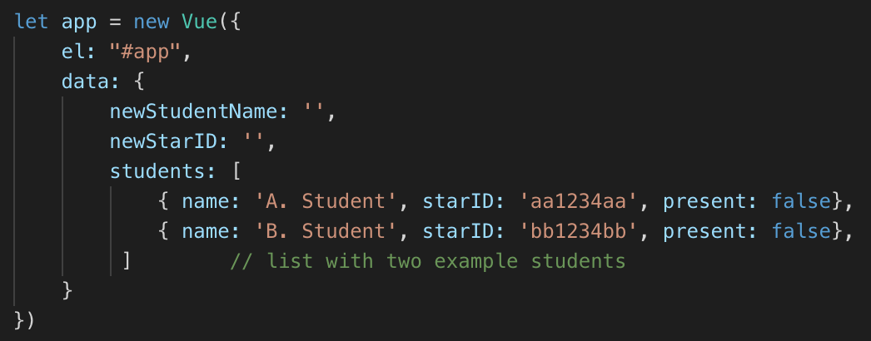
Adding new student
Add two new properties to data
These will be linked to the name and star ID input using v-model
So the app will be able to read what the user has typed into the inputs

Slide 9
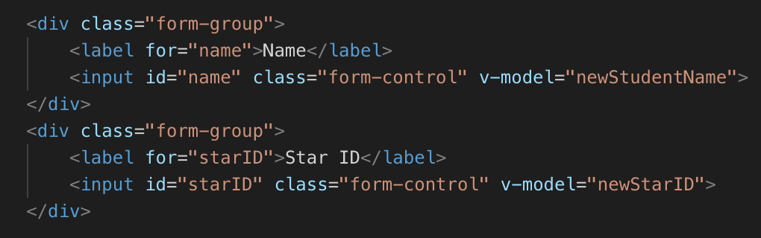
v-model
Find the form, about lines 22
Add v-model attribute to each input

Slide 10
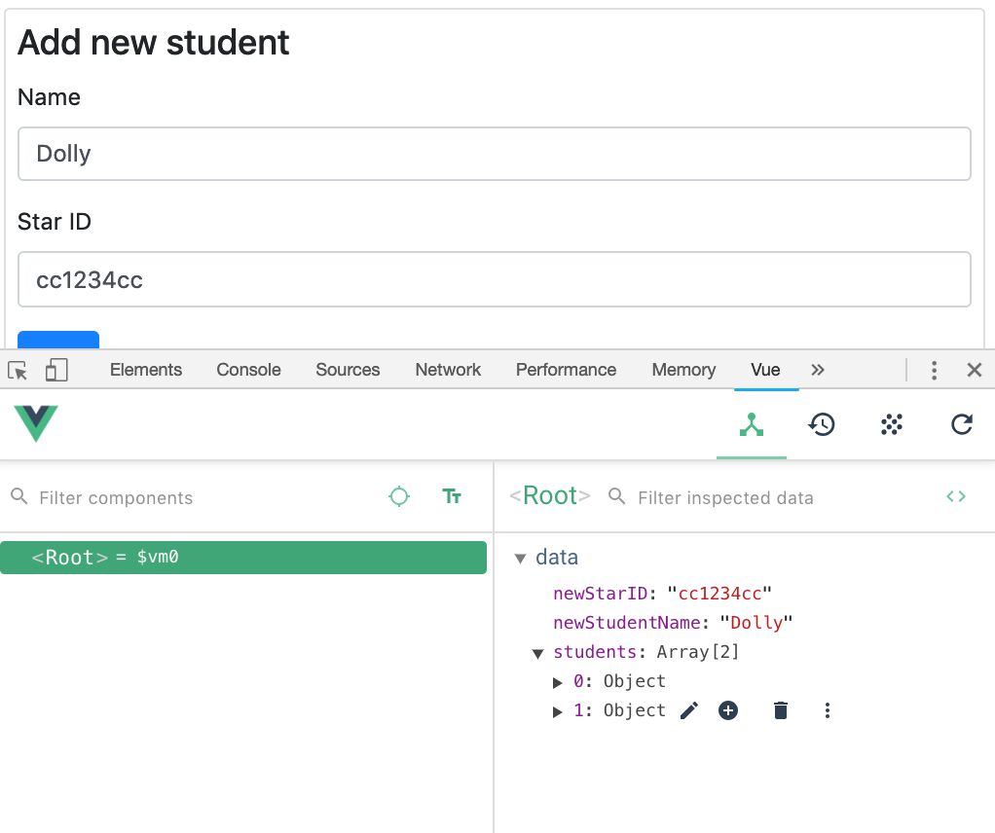
Check in the Vue dev tools
Type some text in the Name and Star ID inputs
Look for the text in the data

Slide 11
Connect the add button
Need the Vue app to respond to the button click event
Find the button, and add v-on:click attribute to call addStudent function

Slide 12
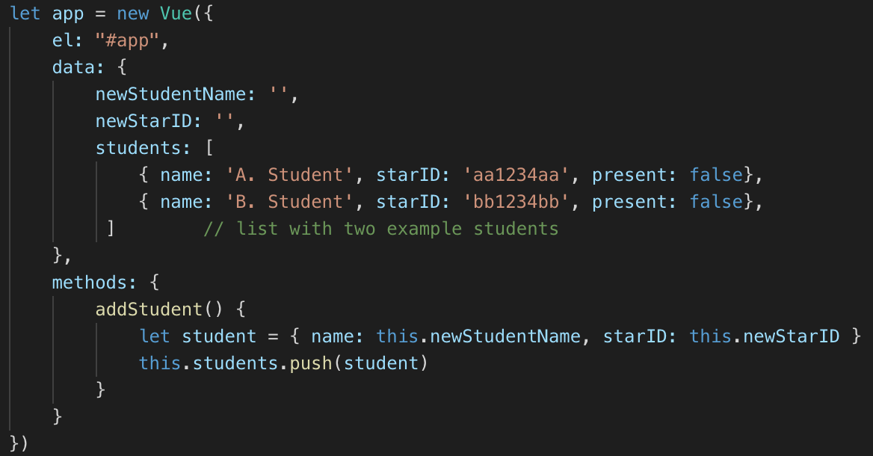
Define addStudent
Create methods property
Define addStudent function
Create new student object, and push onto the end of the students array

Slide 13
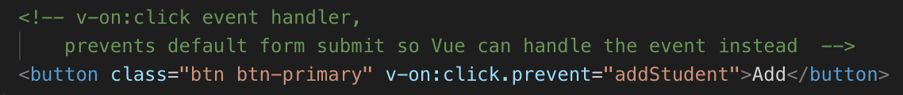
Run and test… not working?
Browser default behavior for a button in a form is to attempt to submit the form to a server, and reload the page
This isn't the desired behavior here – our page will rarely, if ever reload
The Vue app will manage refreshing/updating data as needed
Modify the button v-on:click="addStudent" to
v-on:click.prevent="addStudent"

Slide 14
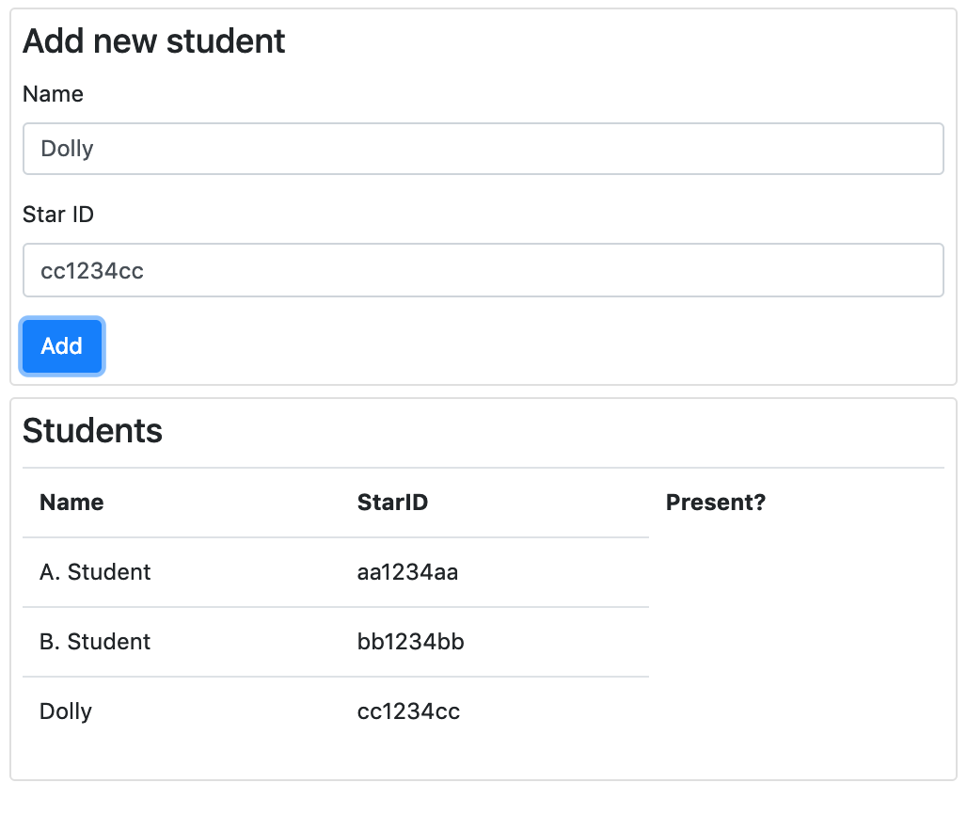
Run and test
Can add new students
No validation
Added student's info stays in the form

Slide 15
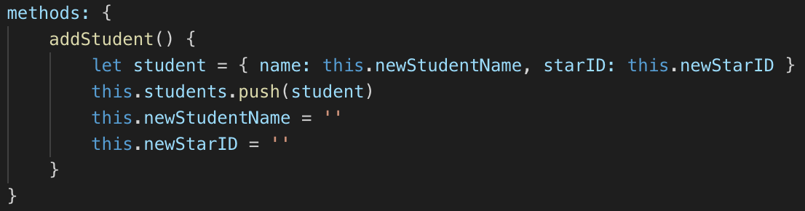
Remove info from form after adding student
Set the newStudentName and newStarID to empty strings
v-model means that if the form changes, the data in the app updates
If the data in the app changes, the form updates

Slide 16
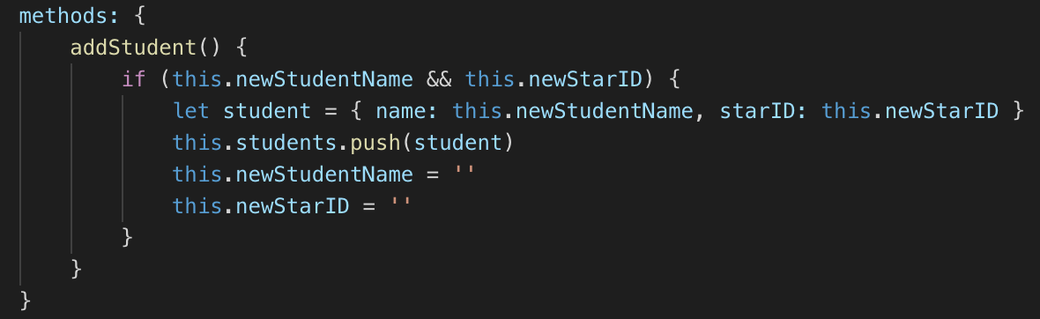
Validation
Check that the name and the starID are both entered
Empty strings are false in JavaScript

Slide 17
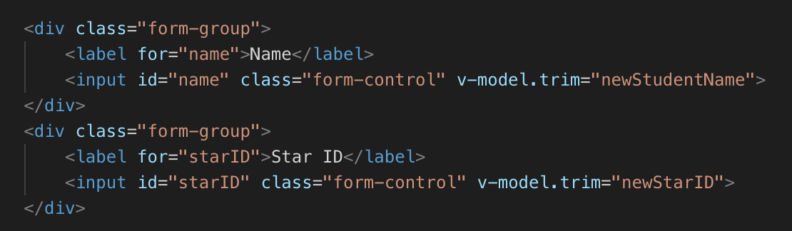
Validation – trimming whitespace
Try entering spaces for a name and starID
A new student is added
Fix: use the .trim modifier
Type spaces into the inputs watch the value in Vue devtools

Slide 18
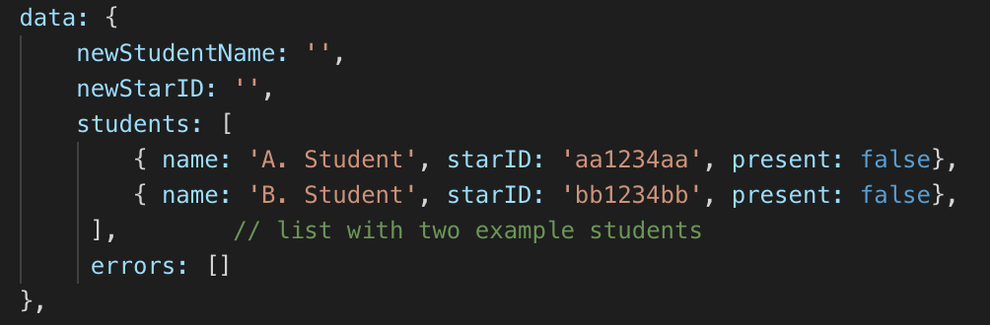
Error message
Feedback for the user if there is an error in the form
Add errors property
Watch the comma after the end of the students list

Slide 19
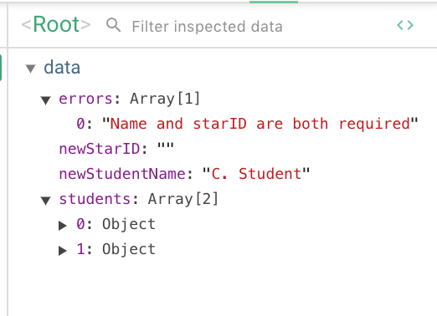
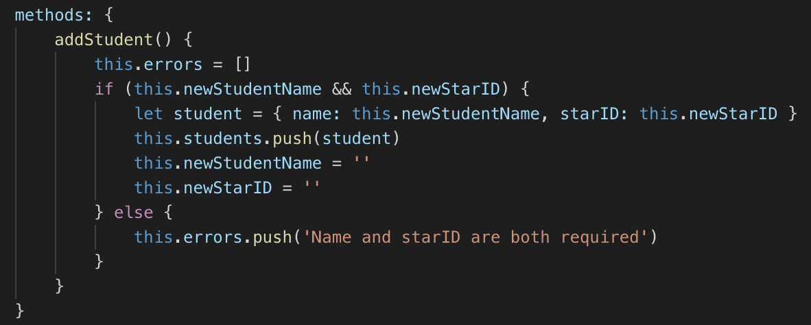
Clear and set error
Try clicking Add with no name or starID
Watch Vue dev tools
Error should clear if name and starid are entered

Slide 20
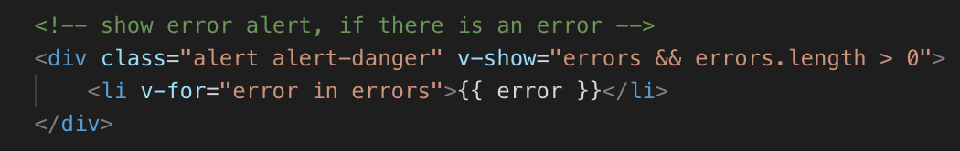
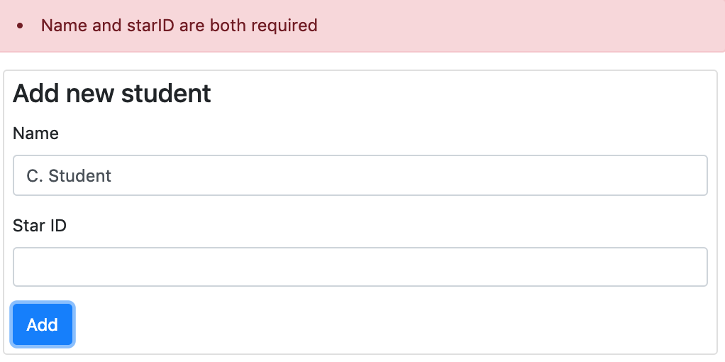
Display error in template
Add this to the top of the page, line ~16
Test

Slide 21
Why a list of errors? Why not a string?
For a more complex form, there are more things that could go wrong
What if the name isn't entered, and the StarID is not valid?
Can show user a list of what needs to be fixed

Slide 22
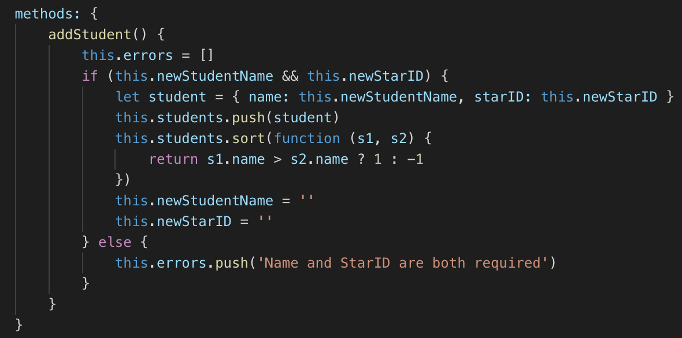
Sort students in alphabetical order
Run and test
Sort function takes another function as an argument
This function will be called with pairs of students
Return negative number 1 if one student should be before second student
Return positive number if one student should be after second student

Slide 23
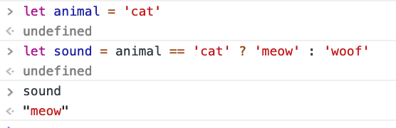
JS Ternary operator
If the condition is true, return 1, otherwise return -1
Can also be used to set
values of variables, for
example ->

Slide 24
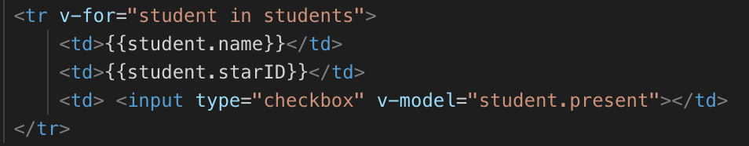
Student present/absent checkbox
Modify the template – add a checkbox to each table row
v-model student.present
Run and test – should see checkbox on each row

Slide 25
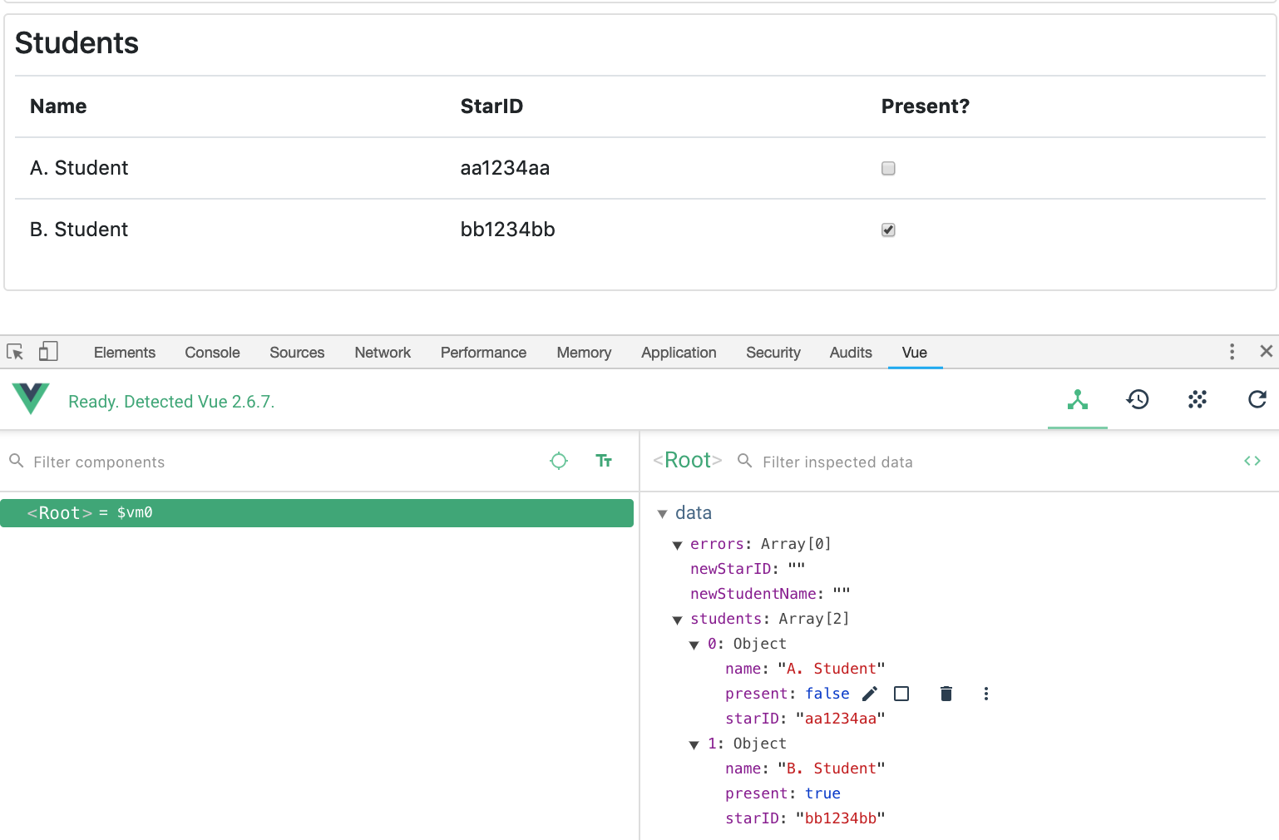
Checkboxes – look at dev tools
Try editing if a student is present in Vue dev tools, the associated checkbox should change
Click on the pencil icon by a property to change the value to true or false

Slide 26
Welcome message
Would like to see a 'Welcome' message for the most recent student to sign in
When a student leaves, show a 'Goodbye' message
Couple of approaches:
Can watch the values of properties and automatically run a function when they are changed – we'll see that in some other examples – but it doesn't work very well with objects in arrays. Hard to tell what changed
Can add a v-on:change event handler that calls a function when the checkbox is changed (checked or unchecked) <- this is easier for this application

Slide 27
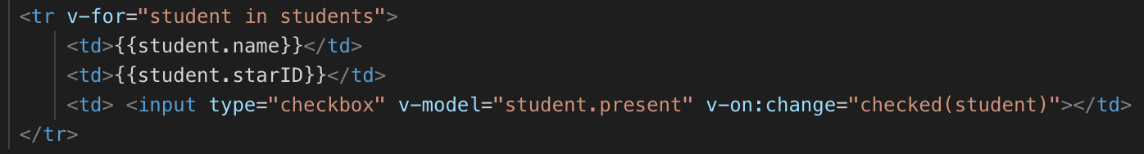
Modify checkbox
Add v-on:change
checked function can take an argument – in this case, the student object that the checkbox is for

Slide 28
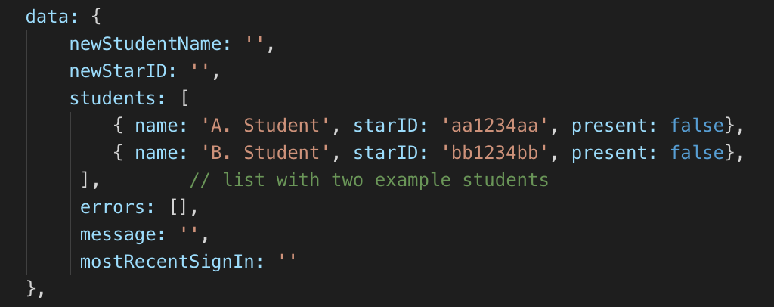
New Data Properties
mostRecentSignIn for most recent signed in/out student name
message for "Welcome" or "Goodbye"

Slide 29
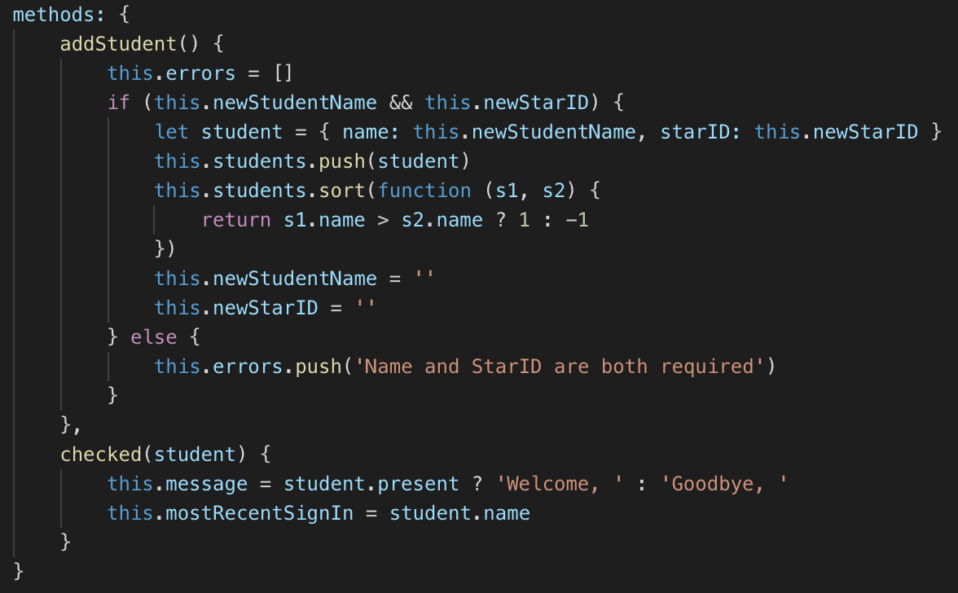
Add checked(student) function to methods
Run and test, check and un-check students Look at the new properties in dev tools

Slide 30
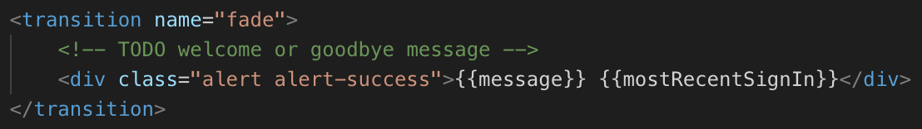
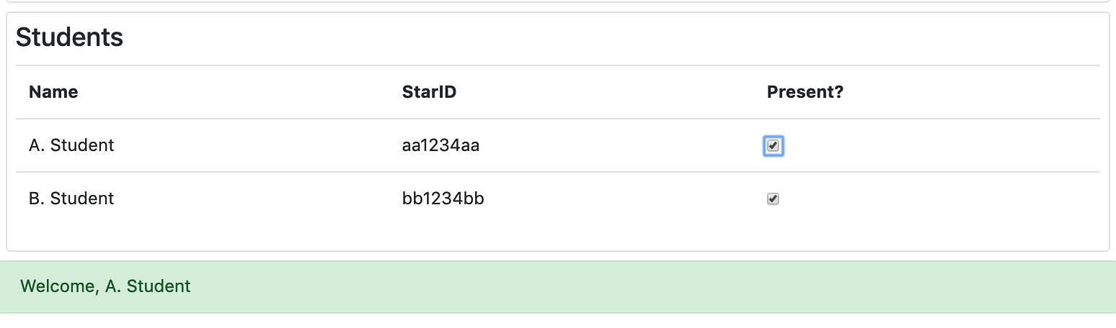
Display message in template
At the end of the template, add an alert div inside the transition element
Run and test

Slide 31
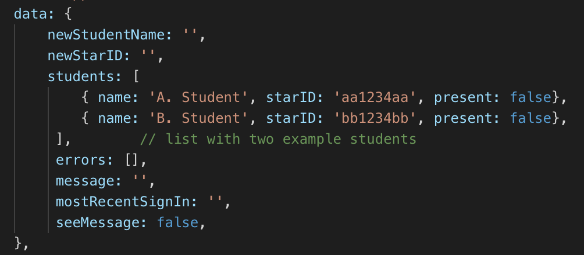
Conditionally seeing the message
New property – should the message be seen or not?

Slide 32
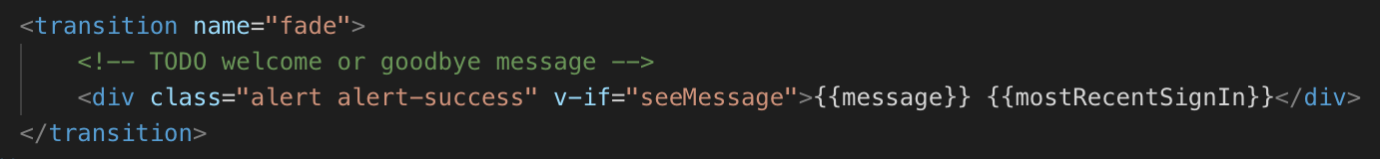
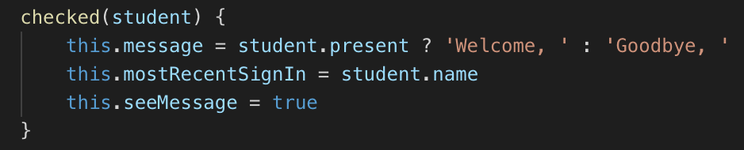
Add v-if to message alert
And set seeMessage = true in checked(student) function

Slide 33
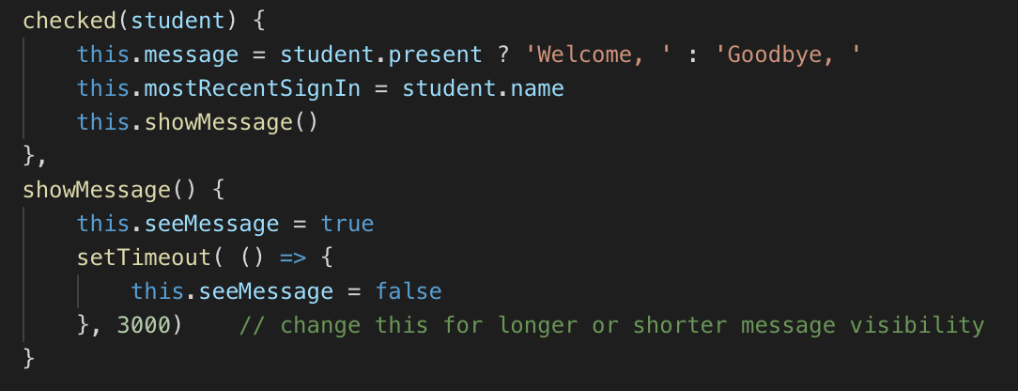
Fading - transition
Modify checked(), add new showMessage function
Call function instead of setting showMessage
Functions are useful in case other parts of the app need to show messages

Slide 34
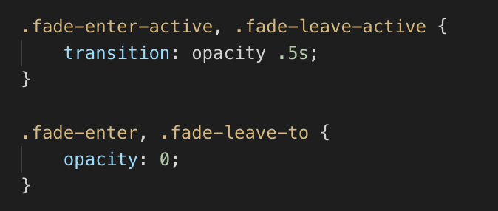
Transitions – in student.css
Vue's classes for CSS transitions, element fades into view and out of view, instead of abruptly appearing and disappearing

Slide 35
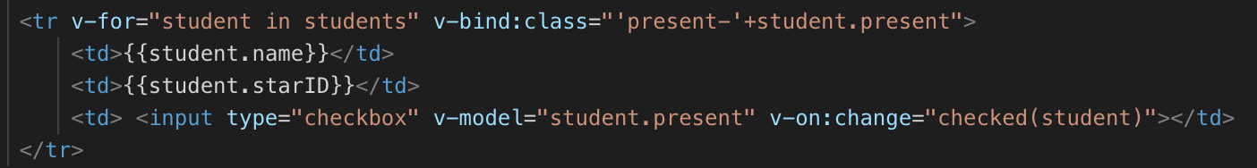
v-bind
Display present, and absent students using different styles
Make it easier to differentiate who is here and who isn't
Students who need to sign in – make their names more prominent so finding their name is easier
Use v-bind:class

Slide 36
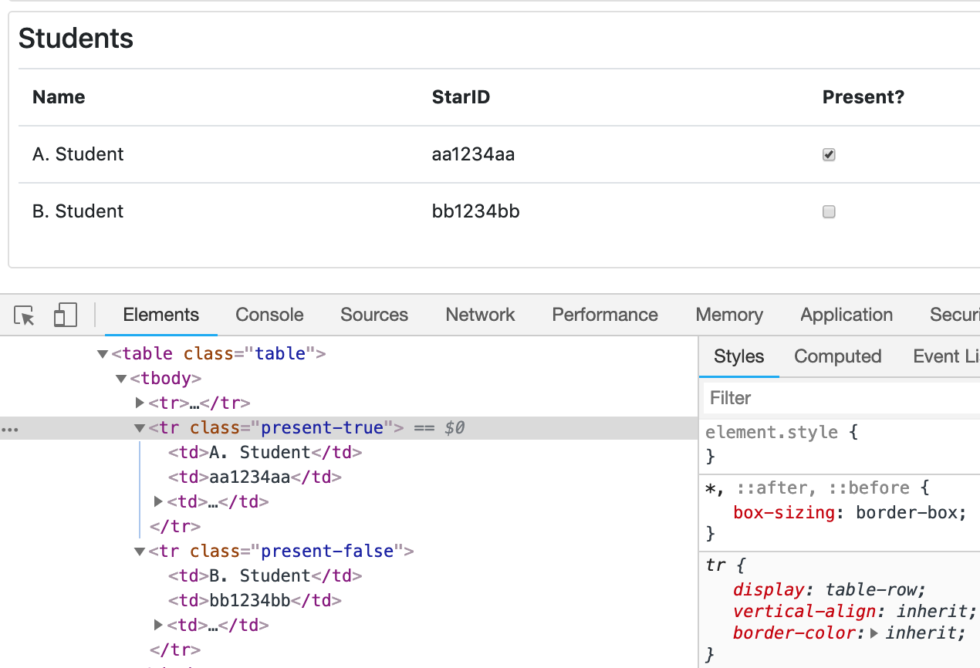
Look at the HTML elements in dev tool
tr elements have class present-true or present-false, depending on whether the student is present or absent
Classes update as the checkboxes are checked/unchecked

Slide 37
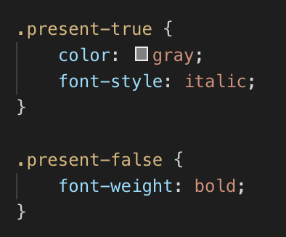
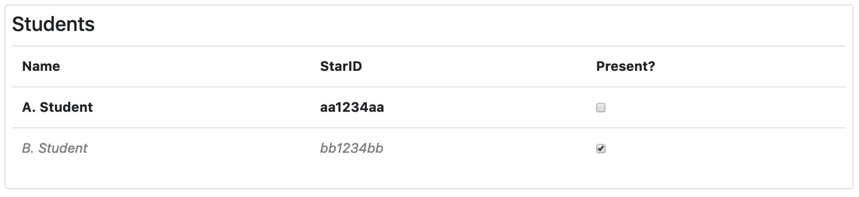
Add styles for .present-true and .present-false classes in student.css

Slide 38
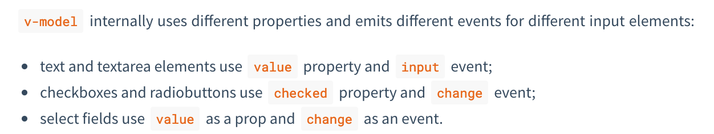
v-bind vs v-model
v-model is two-way
modify element, data changes. Modify data, element changes.
Used for forms, input
v-bind is one-way
sets HTML attributes, text for data
If data changes, attributes/text are updated

Slide 39
v-if and v-else
Elements are added, or removed from DOM based on the truth of the expression after v-if
So if seeMessage is true, the alert div element is part of the DOM
If seeMessage is false, the alert div element is removed (or not added) to the DOM
Can have an element with v-else that's displayed if v-if is false

Slide 40
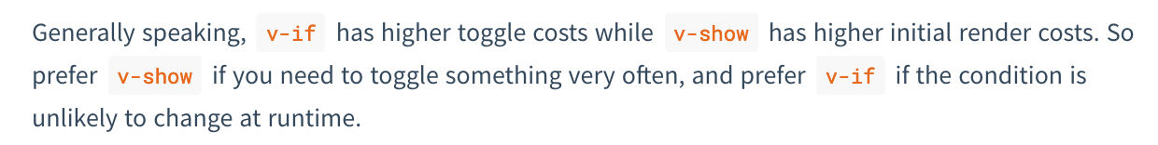
v-show
Element is shown or hidden but still part of the DOM
v-show can't have v-else

Slide 41
@ shortcut
Can replace v-on with @
These are equivalent

Slide 42
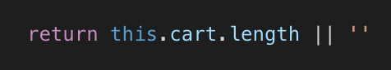
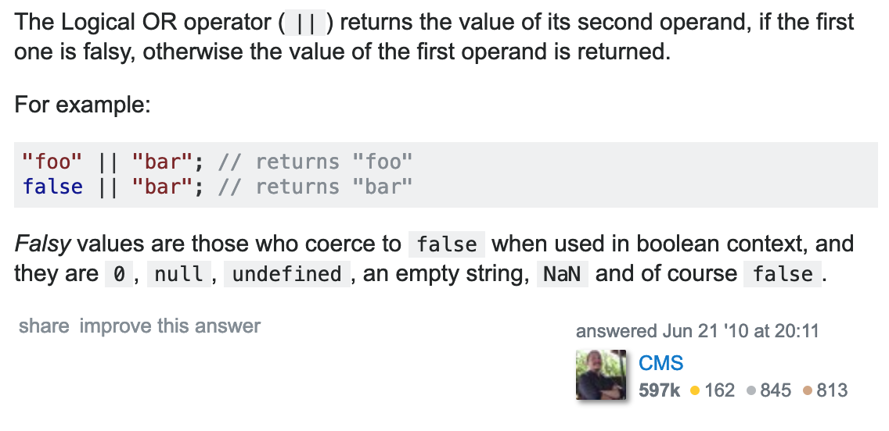
Logical OR operator in JS
0 is considered to be false
Empty strings and 0 are false
Remember the v-if binding that checked if there was text in a input?
This says "Return this.cart.length if it's not 0, otherwise return an empty string"

Slide 43
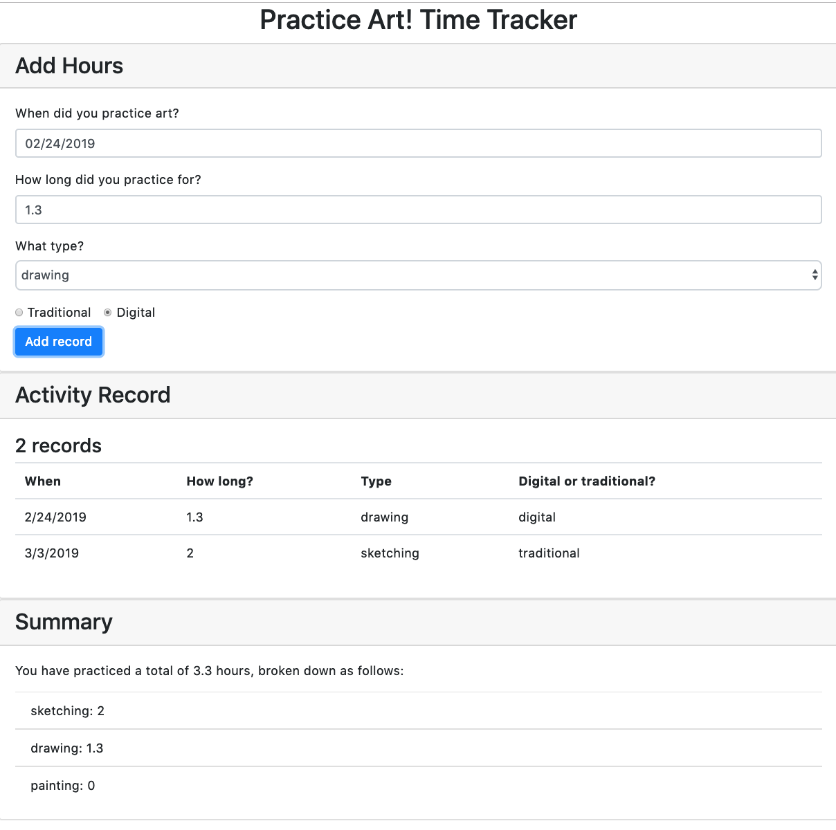
Activity Tracker App
Also in the example repo
Most of the HTML is written for you
Also has Bootstrap

Slide 44
Activity time tracker
For tracking the amount of time spent on an activity – for this example, practicing art
But could also track time
Studying, coding, practicing a language
Sports, training, workouts
etc..
Saves the date the activity was done on
The number of hours
The subtype – in this example, drawing, painting and sketching
An example of using a select-option input
The medium – in this example, digital or traditional (on paper)
Example of using radio buttons

Slide 45
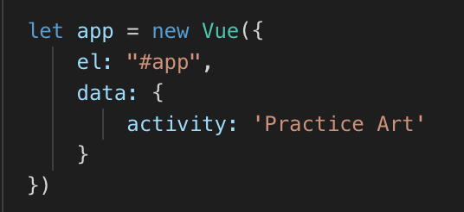
Create new Vue app
In the script tag, new Vue component for the #app div

Slide 46
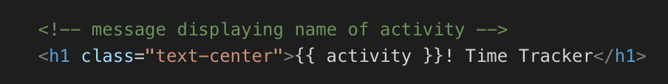
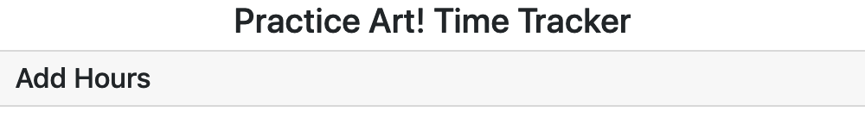
Display the activity in the title
Find the h1 tag at the start of the template
Use the mustache syntax to display the name of the activity

Slide 47
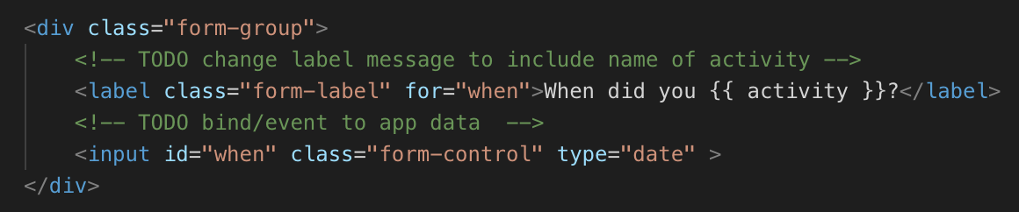
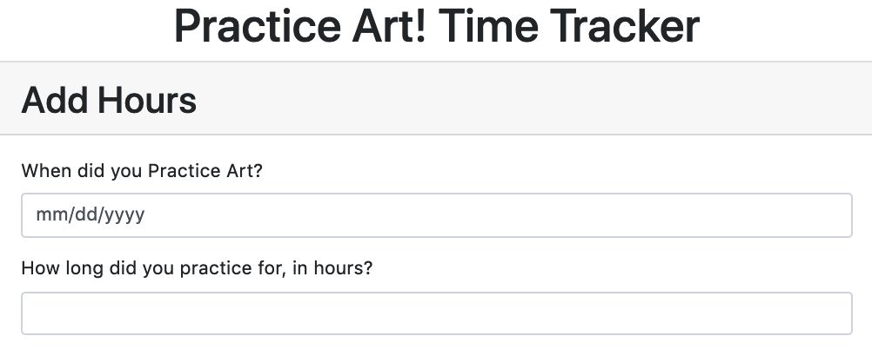
Display the activity name in the input label
Find the first input element's label, ~ line 30, modify text displayed

Slide 48

Filters - modify data in the template
The name of the activity should be lowercase in the label
Create a lowercase filter

Slide 49


Use filter in template
Uses pipe | character
The data is passed as an argument to the filter function, whatever the filter function returns is displayed

Slide 50

Entering new records
Create properties to v-model to form
Array of activityRecord objects
One activityRecord object will have this structure:
{
when: date,
howLong: 1.5,
type: 'painting',
digitalTraditional: 'digital'
}

Slide 51

v-model, how long?
How long is easy – simple v-model

Slide 52

What type?
Add an array of the different types

Slide 53

Select and options – v-model and v-for
Use v-for to create one option element for each type in the types array
Use v-model to connect the selected value to the type data

Slide 54


Run and test
Select element has data
Change the selection, look at the type property in the vue dev tools

Slide 55

Radio buttons
Two new properties, one for digital, one for traditional

Slide 56

Radio buttons
If both radio buttons v-model the same property, when one is selected, the other one will de-select
Need to set the initial value for both too, either value=string, or v-bind:value to a property

Slide 57

Verify in Vue dev tools
digitalTraditional should change depending on what radio button is selected

Slide 58

What's left? The date
Dates are awkward
v-model to the when property
The HTML date picker returns a string that needs to be converted into a date – and we also have to deal with the browser's local timezone

Slide 59

when is a string in the format "YYYY-MM-DD"
Need to convert this string to a date
JS assumes that the new date is in UTC – no time zone
Need to adjust date into the browser's time zone

Slide 60

Computed property whenLocal
Computed properties are calculated from data property/properties
If the data updates, the computed property automatically updates

Slide 61

Verify in Vue dev tools
Date should be midnight on the date selected

Slide 62

submit button
add v-on:click
In this example, the button is type=button so it doesn't try to submit the form, don't need the .prevent modifier

Slide 63


Add methods, add submit function
computed: { ... and filter {…. are collapsed in my editor, don't delete them
Add an example record, verify in dev tools

Slide 64

Displaying records in table
Use v-for to create one row per activityRecord

Slide 65

Test
Records added – verify all data in show in table
Need some input validation – don't accept blank fields, invalid dates, non-numerical values for howLong
Sort by date
Format dates

Slide 66

Validation
Add the .number modifier to the how long input

Slide 67
.number
Useful for validation
Data in a text input (even if it's type="number") is a string
.number modifier converts the data to a number, if it's possible to convert
If not, the original data is returned
"8" -> 8
"8abc" -> 8
"abc" -> "abc"

Slide 68

Add errors array to data
Empty array
Add error messages during validation
Will check the length of the array to check if there are any errors, before processing data

Slide 69

submit method
Set this.errors to empty array
Check if the date is valid
Check if the how long is a valid, positive number
If no errors, create new record

Slide 70

Test – use dev tools
Error message for each problem

Slide 71


Display errors to user
Add this to the template, above the form

Slide 72

Filter for formatting dates
This isn't very readable

Slide 73

New filter: shortDateFormat
Add to filters

Slide 74


Apply filter to when property in table
Run and test
Dates should be MM/DD/YYYY

Slide 75

Sorting records
Modify submit() function
Sort with oldest first, most recent at the end
If you prefer, reverse the order

Slide 76

Run and test
Add dates, verify oldest at the top of the table
Your turn - can you modify the sort function to sort with most recent first?

Slide 77


Inline JavaScript expressions
How many records?
Replace this ---->
With this – note the {{ }} syntax

Slide 78

Number of records
Inline JavaScript should be used minimally
It's usually best to keep logic out of your templates
Your turn: can you re-implement the count as a computed property?

Slide 79

totalHours computed property
reduce method calculates the total. Could also use
total = 0
this.activityRecords.forEach(function(record) {
total += record.howLong
})

Slide 80

Run and test
Total displayed

Slide 81

Total broken down by type
Another computed property – add to the computed properties
For each type, filter the records for that type and add up all the hours

Slide 82

Template – use v-for to display list
totalHoursByType is an object
Watch the order of arguments
value key

Slide 83

Run and test
Add some example records, verify sums are correct

Slide 84
.lazy
v-model.lazy modifier
Data is updated after a change event, not an input event
In a text input, the input event fires after every keystroke
the change event fires when the user navigates away from a textbox
If you only need to make updates once the user has typed the entire text, not as they are typing, use the .lazy modifier
Can use number and lazy modifiers together

Slide 85

Add .lazy to hours text input, date input
Change the value of either input, watch the vue dev tools – when do the values change?

Slide 86
Finishing up
Verify everything is working as described
Create a new GitHub repository
In your terminal, run these commands
git add . // adds all the changes
git commit –m 'lab work' // commit
git checkout master // checkout master branch
git merge base // merge your work into master branch
git remote set-url origin your-github-repo // change the remote to your GitHub
git push origin master // push work

Slide 87
Lab in D2L

